Slide 1
Project Name: Visualization of iterative deepening search with an Android Application
Team name: BANTI
Team members:
Abeda Sultana(16)
Tisa Islam Erana(31)
Najmun Nahar Bhuiyan (64)
Nasid Habib Barna (66)

Slide 2
Introduction
Iterative deepening search or more specifically iterative deepening depth first search (IDS or IDDFS) is a state space or graph search strategy.
Combination of depth–first search and breadth-first search.
Combines the space-efficiency of depth-first searching with the ordering of breadth-first searching.

Slide 3
Features
The main feature of our project is to give clear conception of iteration deepening searching method to user.
We’ll add theory on this topic.
Showing animation on searching.
It’ll be compatible in AP19 : android 2.3 and the upper versions
We’ll try to give attractive graphical interface in our application.

Slide 4
Functional Requirement
Theory on iterative deepening search.
Fixed graph for searching process
User specified input
Fixed input
Result
FAQ

Slide 5
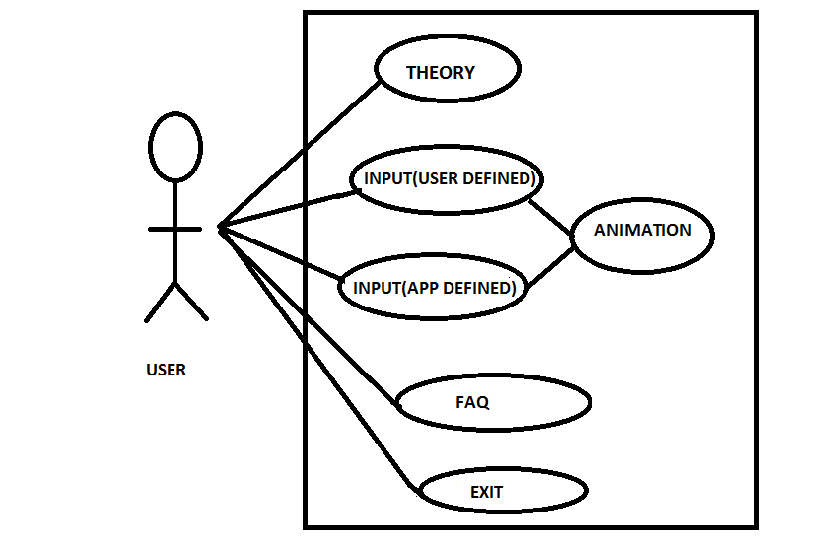
USE CASE DIAGRAM IDS VISUALIZATION APPLICATION

Slide 6
THANK YOU

